Slide 1
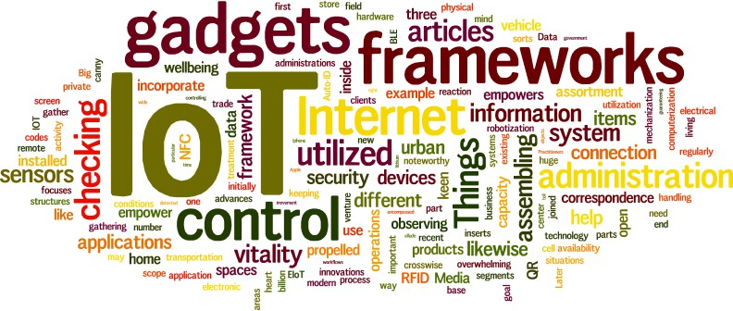



CS578: Internet of Things
IoT Ecosystem
Different components of IoT
“Strength is Life, Weakness is Death.” – Swami Vivekananda

Slide 2

IoT Ecosystem
IoT is not just a technology; it is an ecosystem!
Community components:
IoT Frameworks
Tools needed to design and implement IoT-based solutions and products
IoT Architectures
Graphical structure of the designed IoT-based solutions and products
IoT Core
Sensors & Actuators, microcontrollers, internet connectivity, service platform including security
IoT Gateway
It carries the responsibility to ensure bidirectional communication between IoT protocols and other networks
Cloud
Accepts, accumulates, maintains, stores, and process data in real time
Analytics
It indulges in conversion and analysis of data which results in recommendations and future decision making
User Interface / Visualization
Design sleek, visually appealing, interactive, and ease-of-use graphical user interface

Slide 3
IoT Framework
Framework provides a development environment.
It provides appropriate infrastructure to design and implement the architecture
IoT framework comprises of large number of components
sensors, sensor systems, gateways, mobile app, embedded controller, data management
platform, analytical platform, and so on.
support interoperability among all devices, provides secure connectivity, reliability in data
transfer, interface to 3rd party application to built on it, and so on.
Few IoT Framework | Few IoT Framework
RTI (Real-Time Innovations) Connext DDS | Cisco Ultra IoT
Salesforce IoT cloud | Microsoft Azure IoT
Eclipse IoT | PTC ThingWorx
GE (General Electronic) Predix | Amazon AWS IoT
IBM Watson IoT | Kaa

Slide 4
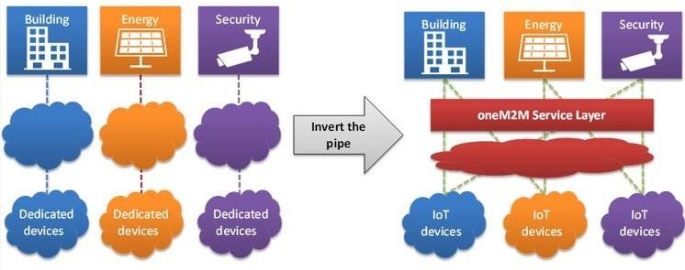
IoT Network Architecture
Network and its application should never be built without careful planning
Architecture is how you design (i.e. graphical structure) your application or solution.
The practice of building single-purpose and “vertical” domain applications leads to isolated silos.
Using the smart building use case, a security application can detect when nobody is in the building.
It could then trigger lights to be switched off and for the air conditioning system to operate on a reduced setting.
Source: https://onem2m.org/using-onem2m/developers/basics

Slide 5


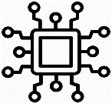
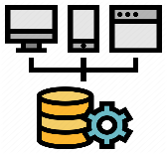
Core Components of IoT
Sensors - to gather data and events
Actuators – responsible for moving and controlling a mechanism or system
Sensors & Actuators
Internet
Connectivity
Microcontrollers - automatically controls sensors and actuators; makes them smart
Internet connectivity – responsible for
sharing information and control command
Micro
controllers
Service
Platform
Service Platform – ability to deploy and manage the IoT devices and applications including data management, data analytics and all aspects of security

Slide 6
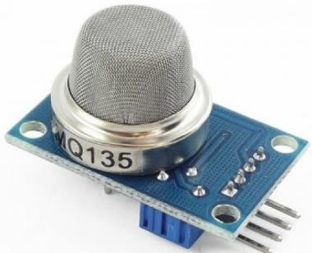
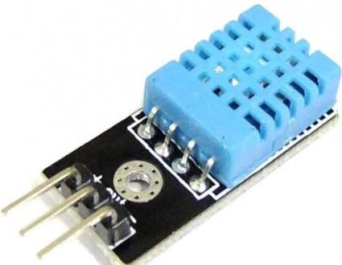
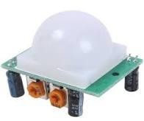
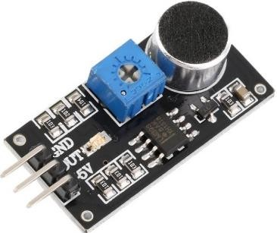
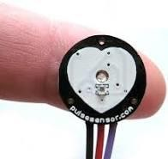
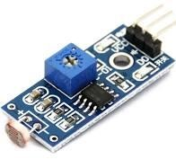
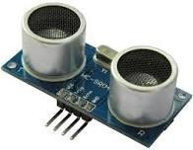
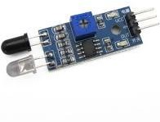
“Things” in IoT – Sensors
MQ135 - Air Quality
Gas Sensor
Sound Detection
Sensor
DHT11 - Temperature
and Humidity Sensor
PIR Motion Detector
Sensor
Pulse Sensor
LDR Light Sensor
Ultrasonic Distance
Sensor
IR Sensor

Slide 7
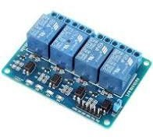
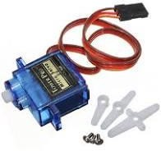
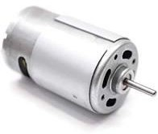
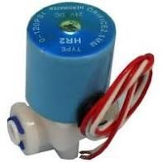
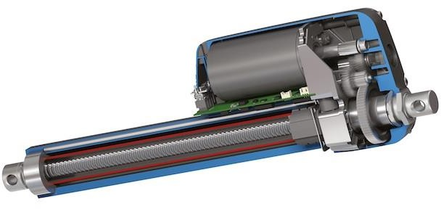
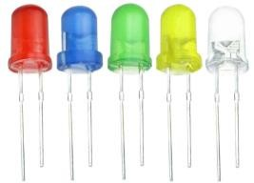
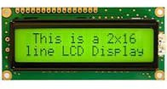
“Things” in IoT – Actuators
4 Channel 5V Relay
Servo Motor
DC Motor
Solenoid valve
Linear Actuators
LED
LCD Diplay

Slide 8

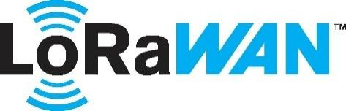


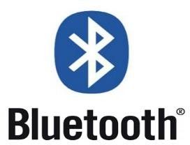
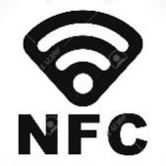



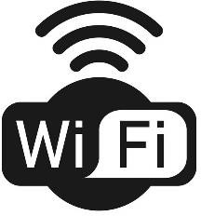



Access Technologies in IoT
Communication Criteria
Range
Frequency Bands
Power Consumption
Topology
Constrained Devices
Constrained-Node
Networks
IoT Access Technologies

Slide 9
Comparison of Key Attributes
 | WiFi | BLE | Thread |  | Sub-GHz: TI |  | Sigfox |  | Zigbee | LoRa
Max. Data throughput | 72 Mbps | 2 Mbps | 250 Kbps |  | 200 Kbps |  | 100 bps |  | 250 Kbps | 50 Kbps
Range | 100 m | 750 m | 100 m |  | 4 km |  | 25 km |  | 130 m | 10 km
Topology | Star | P2P/ Mesh | Mesh/ Star |  | Star |  | Star |  | Mesh/ Star | Star of Star
Frequency | 2.4 GHz | 2.4 GHz | 2.4 GHz |  | Sub-GHz |  | Sub-GHz |  | 2.4 GHz | Sub-1GHz
Power consumption | 1 Year (AA battery) | Up to years on a coin-cell battery for limited range |  |  |  |  |  |  |  | Few Years (AA battery)
IP at the device node | Yes | No |  | Yes |  | No |  | No | No | No
Deployed Devices | AP | smart phones |  | No |  | No |  | No | No | No
Source: Nick Lethaby “Wireless Connectivity for the IoT: one size does not fit all”, Texas Instruments, 2017

Slide 10
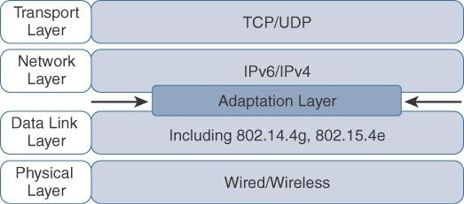
Use of Internet
Key Advantages of IP
Open and standard-based
Versatile
Ubiquitous
Scalable
Manageable
Highly secure
Stable and resilient
IPv6 packets require a minimum MTU/PDU size of 1280 bytes.
The maximum size of a MAC layer frame in IEEE 802.15.4 is 127 bytes.
It gives just 102 bytes for an IPv6 packet !!
Need of packet/frame size optimization due to
Constrained Nodes
Constrained Networks

Slide 11
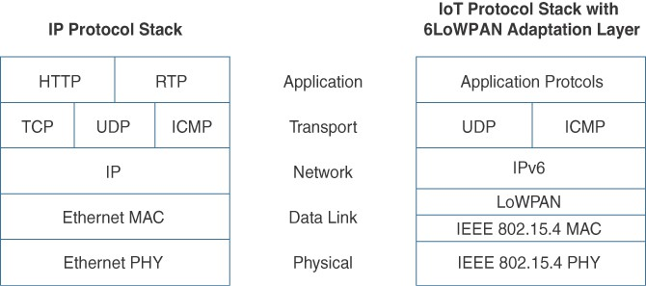
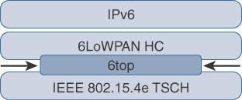
Modification in TCP/IP Stack
IEEE 802.15.4e -
2011 Amendment
WPAN: Wireless Personal Area Networks
IEEE 802.15.4: Low-rate WPAN
In 6TiSCH IoT Network
LoWPAN: Low-Power WPAN
6LoWPAN: IPv6 over LoWPAN
TSCH: Time Synchronized Channel Hopping
6TiSCH: IPv6 over the TSCH mode of IEEE 802.15.4e
6top: 6TiSCH Operation Sublayer

Slide 12
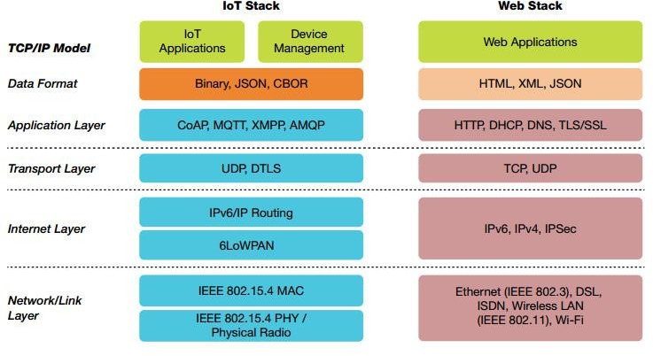
Application Layer

Slide 13
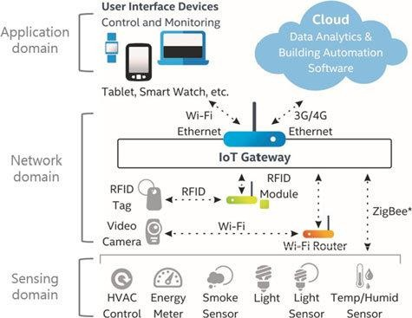
IoT Gateway
It is a physical device or software program that serves as the connection point between the two different types of networks
Provide bidirectional communication
Between IoT protocols and other
networks
e.g. Zigbee <--> Ethernet
Sometimes programmed to execute some processing operations
Edge computing
It is necessary to maintain security to a
certain extent
Can shield the entire IoT systems from
any cyberattack
Source: B. Kang, D. Kim, H. Choo, “Internet of Everything: A Large-Scale Autonomic IoT Gateway”,
IEEE Transactions on Multi-scale Computing Systems, vol. 3, no. 3, 2017, pp. 206-214.

Slide 14
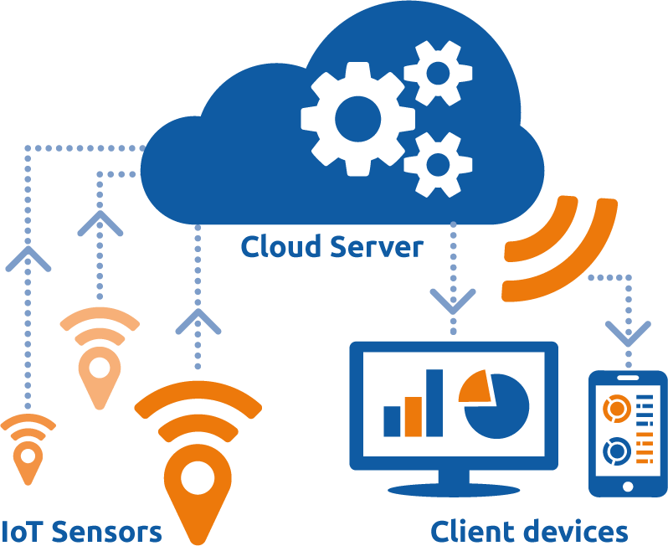
Use of Cloud
IoT generates vast amount of Big Data;
this in turn puts a huge strain on
Internet Infrastructure.
Cloud can facilitate to
Provide different services
Store huge amount of data
Process the data efficiently
Benefits of Cloud Platform in IoT
Network Scalability
Data Mobility
Time to market
Security
Cost-effectiveness

Slide 15
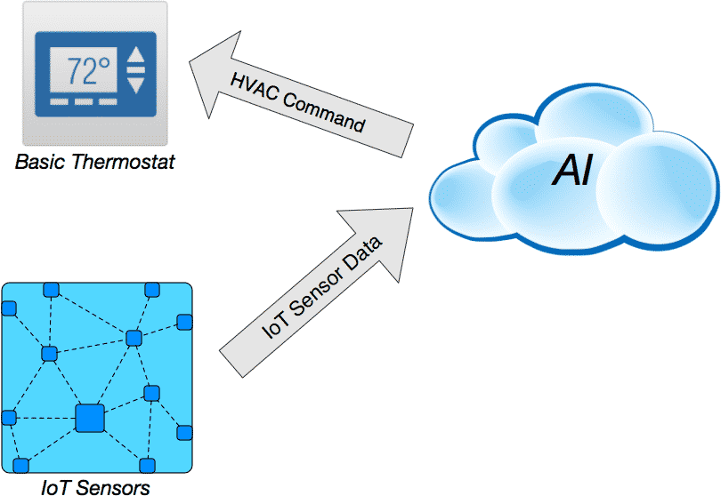
AI for IoT
AI focuses on putting human intelligence in machine
It gives the ability to a machine/program to think and learn by itself
Use of AI in IoT:
Smart Home
Automated HVAC control
Industrial IoT
Predictive maintenance
Optimized supply chain
Farming
Smart farming
Interruption warning
Self-driving Car
Mimic human driving on road
Health
Auto-diagnosing any disease
Assistive healthcare

Slide 16
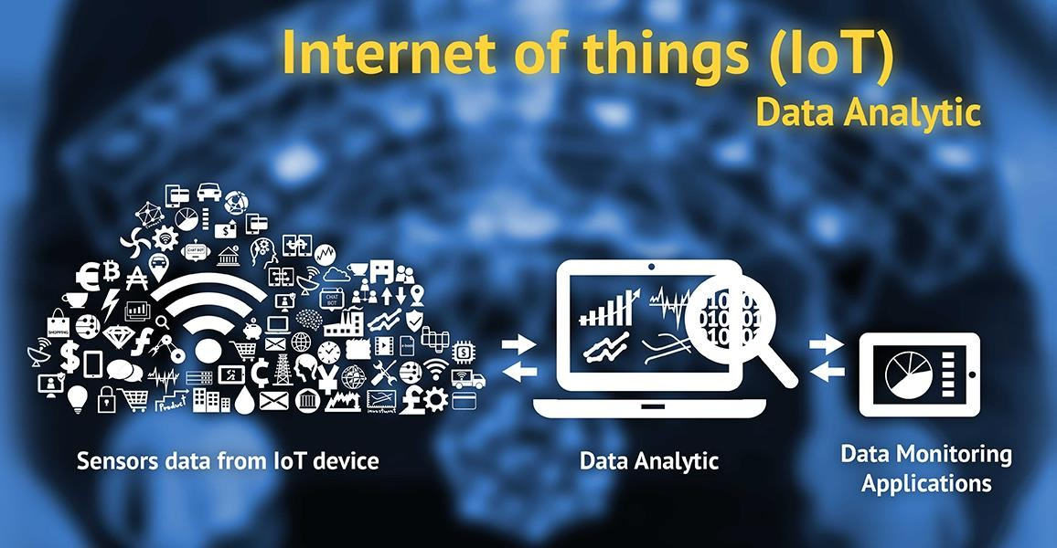
Data Analytics in IoT
“Data Analytics + IoT => Smart Business Solutions”
The business value of IoT is not just in the ability to connect devices, but it comes from understanding the data these devices create.
Challenges:
Huge Volume
Real-time data flow
Variety of data types
e.g. XML, video, SMS
Unstructured data
Variable data model and meaning / value
IoT analytics is the application of data analysis tools and procedures to realize
value from the huge volumes of data generated by connected IoT devices

Slide 17

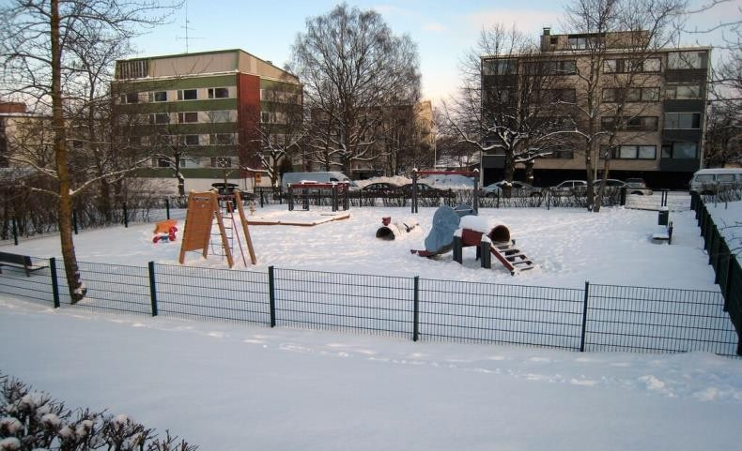
Securing IoT
Both the IoT manufacturers and their customers didn’t care about the security !
Unauthorized access to IoT devices
Unauthorized access to IoT network
Source:https://www.theguardian.com/technology/2016/oct/26/ddos- attack-dyn-mirai-botnet
Source:http://metropolitan.fi/entry/ddos-attack-halts-heating-in-
finland-amidst-winter
Major cyber attack disrupts internet service across Europe and US; October 26, 2016
DDoS attack halts heating in Finland amidst winter; November 7, 2016

Slide 18
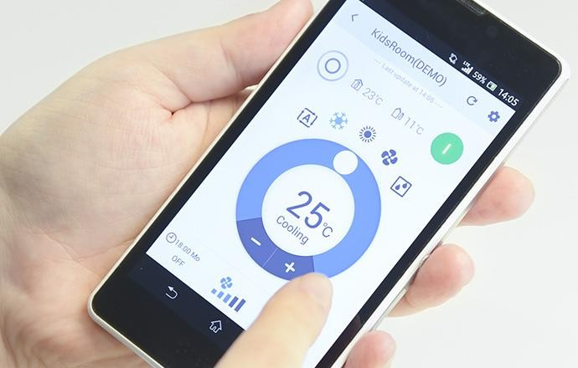
User Interface
Information made available to the end-users
Users can actively check and act in for their IOT system
Important
Characteristics:
Sleek design
Visually appealing
Interactive UI
Ease-of-use
Handy
Source: https://www.daikin.com/about/design/2017/05/entry-15

Slide 19
Lessons Learned
What is IoT Ecosystem
Different components of IoT
IoT Framework
IoT Architecture
IoT Core
Sensors & Actuators
IoT Access Technologies
IoT Gateway
Use of Cloud in IoT
Data Analytics in IoT
AI for IoT
Security in IoT
User Interface for IoT

Slide 20

Figures and slide materials are taken from the following Books:
1. David Hanes et al., “IoT Fundamentals: Networking Technologies, Protocols,
and Use Cases for the Internet of Things”, 1st Edition, 2018, Pearson India.

Slide 21

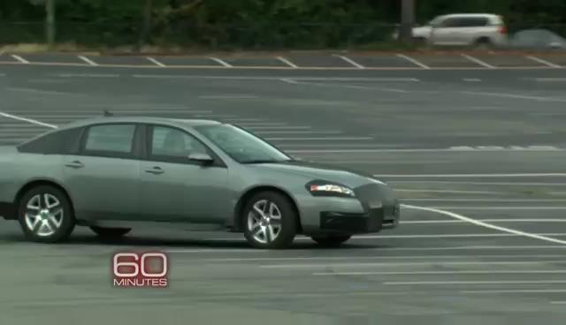
Security in IoT
US Military’s Defense Advanced Research Projects Agency (DARPA) demonstrates hacking smart “Things”
Source: https://www.youtube.com/watch?v=7E1WsdODxu0
Source: https://www.youtube.com/watch?v=4oONdV5RYp8

